Slide 1


David Nicewonder
June 24, 2024

Slide 2

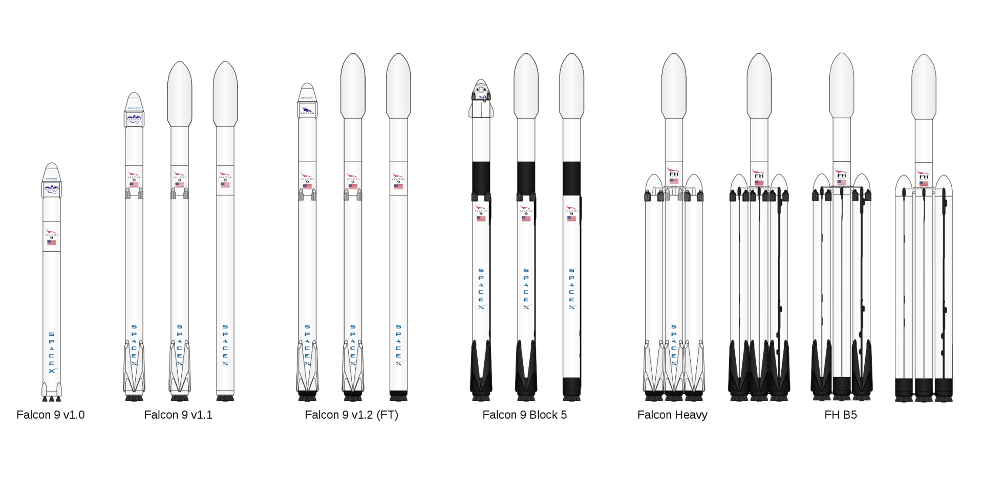
Outline
Executive Summary
Introduction
Methodology
Results
Conclusion
Appendix

Slide 3
Executive Summary
In this capstone project, data was collected and modeled to predict if the Falcon 9 first stage will land successfully. The dataset includes a record for each payload carried during a SpaceX mission. This information can be used if an alternate company wants to bid against SpaceX for a rocket launch.
SpaceX advertises Falcon 9 rocket launches on its website with a cost of 62 million dollars; other providers cost upward of 165 million dollars each.
Much of the savings is because SpaceX can reuse the first stage. Therefore if we can determine if the first stage will land successfully, it can assist with determining the cost of a launch.

Slide 4
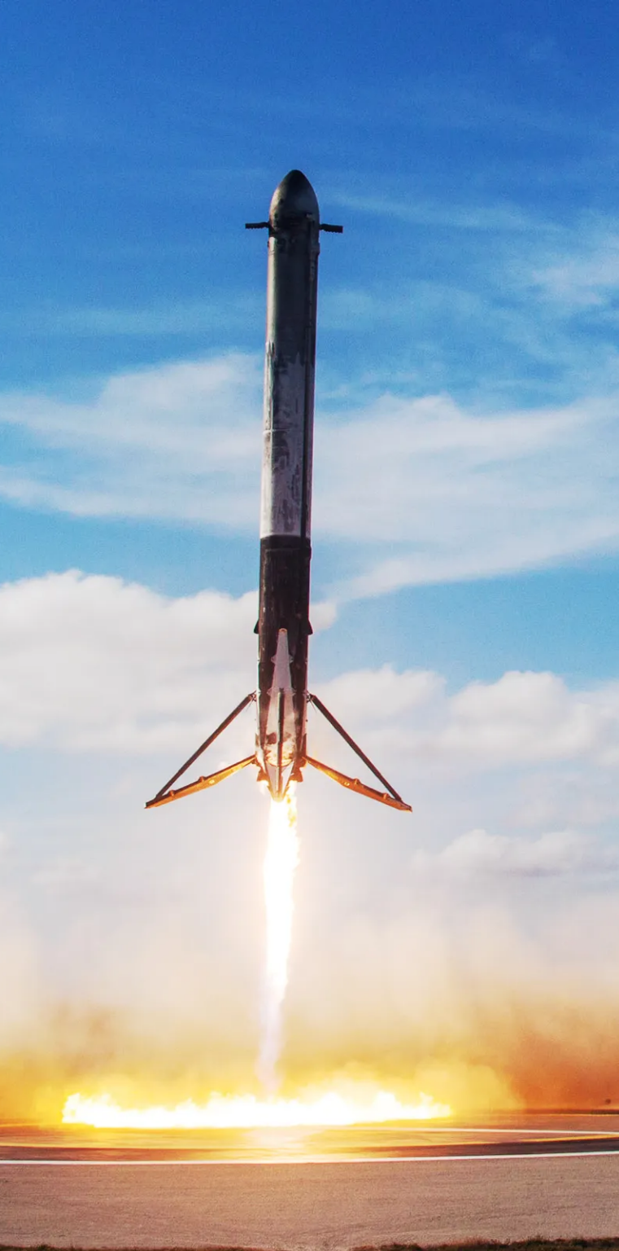
Introduction
The project goal is to use data to predict whether SpaceX will attempt to land a rocket or not.
In this capstone project, SpaceX launch data was gathered from the SpaceX REST API.
The data included information about launches, the rocket used, payload delivered, launch specifications, landing specifications, and landing outcomes.
Exploratory Data Analysis (EDA) and data visualization to understand the data and to answer project questions.

Slide 5

Section 1

Slide 6
Methodology
Executive Summary
Data collection methodology:
SpaceX launch data was collected using the SpaceX REST API.
Perform data wrangling:
The API data was converted from structured JSON and normalized to a dataframe flat table saved to a CSV file.
Perform exploratory data analysis (EDA) using visualization and SQL
Perform interactive visual analytics using Folium and Plotly Dash
Perform predictive analysis using classification models

Slide 7
Data Collection
SpaceX launch data was collected using the SpaceX REST API.
The API data was converted from structured JSON and normalized to a Pandas dataframe, which was saved to a CSV file.
Additional data was gathered by web scraping HTML tables from Wikipedia for SpaceX launch records information using BeautifulSoup. This data was combined with the dataframes.

Slide 8
Data Collection – SpaceX API
Request rocket launch data from SpaceX API: https://api.spacexdata.com/v4/launches/past
GitHub URL of the completed SpaceX API calls notebook: https://github.com/davidnicewonder/IBM-Applied-Data-Science-Capstone/blob/main/jupyter-labs-spacex-data-collection-api.ipynb
Request and parse the SpaceX launch data using the GET request
Decode the response content as a Json using .json() and turn it into a Pandas dataframe using .json_normalize()
Filter the dataframe to only include Falcon 9 launches

Slide 9
Data Collection - Scraping
Request the Falcon9 Launch Wiki page from its URL
Wikipedia: https://en.wikipedia.org/w/index.php?title=List_of_Falcon_9_and_Falcon_Heavy_launches&oldid=1027686922
GitHub URL of the completed web scraping notebook: https://github.com/davidnicewonder/IBM-Applied-Data-Science-Capstone/blob/main/jupyter-labs-webscraping.ipynb
Create a BeautifulSoup object from the HTML response
Extract all column/variable names from the HTML table header
Create a data frame by parsing the launch HTML tables

Slide 10
Data Wrangling
Calculate the number of launches on each site
Performed Exploratory Data Analysis (EDA) to find patterns in the data and determine what would be the label for training supervised models.
Calculated the number of landing outcomes using value_counts() on the column Outcome to determine the number of landing outcomes.
GitHub URL of your completed data wrangling related notebook: https://github.com/davidnicewonder/IBM-Applied-Data-Science-Capstone/blob/main/labs-jupyter-spacex-Data%20wrangling.ipynb
Calculate the number and occurrence of each orbit and occurence of mission outcome of the orbits
Create a landing outcome label from Outcome column
Calculate landing outcomes

Slide 11
EDA with Data Visualization
Summary of charts (launch outcomes):
FlightNumber vs. PayloadMass
FlightNumber vs. LaunchSite
Payload vs. Launch Site
Orbit Success Rate
FlightNumber and Orbit Type
Payload vs. Orbit
Maps
GitHub URL of EDA with data visualization notebook: https://github.com/davidnicewonder/IBM-Applied-Data-Science-Capstone/blob/main/edadataviz.ipynb

Slide 12
EDA with SQL
Summary of SQL queries:
Display the names of the unique launch sites in the space mission.
Display 5 records where launch sites begin with the string 'CCA'.
Display the total payload mass carried by boosters launched by NASA (CRS).
Display average payload mass carried by booster version F9 v1.1.
List the date when the first successful landing outcome in ground pad was achieved.
List the names of the boosters which have success in drone ship and have payload mass greater than 4000 but less than 6000.
List the total number of successful and failure mission outcomes.
List the names of the booster_versions which have carried the maximum payload mass.
List the records which will display the month names, failure landing_outcomes in drone ship ,booster versions, launch_site for the months in year 2015.
Rank the count of landing outcomes (such as Failure (drone ship) or Success (ground pad)) between the date 2010-06-04 and 2017-03-20, in descending order.
GitHub URL of EDA with SQL notebook: https://github.com/davidnicewonder/IBM-Applied-Data-Science-Capstone/blob/main/jupyter-labs-eda-sql-coursera_sqllite.ipynb

Slide 13
Build an Interactive Map with Folium
Summary of maps and objects:
Mark all launch sites on a map.
Mark the success/failed launches for each site on the map.
Calculate the distances between a launch site to its proximities
Map objects such as markers, circles, and lines were added to the Folium maps to better visualize and orient for real-world locations of launch sites and landing success rates.
GitHub URL of interactive map with Folium map: https://github.com/davidnicewonder/IBM-Applied-Data-Science-Capstone/blob/main/lab_jupyter_launch_site_location.ipynb

Slide 14
Build a Dashboard with Plotly Dash
Summary of Dashboard plots/graphs and interactions:
Pie chart
Scatter plot
Launch site dropdown selector
Payload mass slider selector
The plots and interactions allow decision makers to interact directly with the data to update the plots and charts. This information can help answer their questions in real-time.
GitHub URL of Plotly Dash lab: https://github.com/davidnicewonder/IBM-Applied-Data-Science-Capstone/blob/main/spacex_dash_app.py

Slide 15
Predictive Analysis (Classification)
Summarize how you built, evaluated, improved, and found the best performing classification model:
Four different models were used: Decision Tree, Logistic Regression, Support Vector Machine, and K Nearest Neighbors.
Each model used a GridSearchCV cross validation to find the best fit from a set of hyperparameters.
Accuracy score and confusion matrix were used to evaluate and compare results.
GitHub URL of predictive analysis lab: https://github.com/davidnicewonder/IBM-Applied-Data-Science-Capstone/blob/main/SpaceX_Machine%20Learning%20Prediction_Part_5.ipynb

Slide 16
Results
Exploratory data analysis results:
Different launch sites have different success rates. CCAFS LC-40, has a success rate of 60 %, while KSC LC-39A and VAFB SLC 4E has a success rate of 77%.
Interactive analytics demo in screenshots
See following slides.
Predictive analysis results:
Although all models had an accuracy near 85%, the Decision Tree performed slightly better.

Slide 17

Section 2

Slide 18
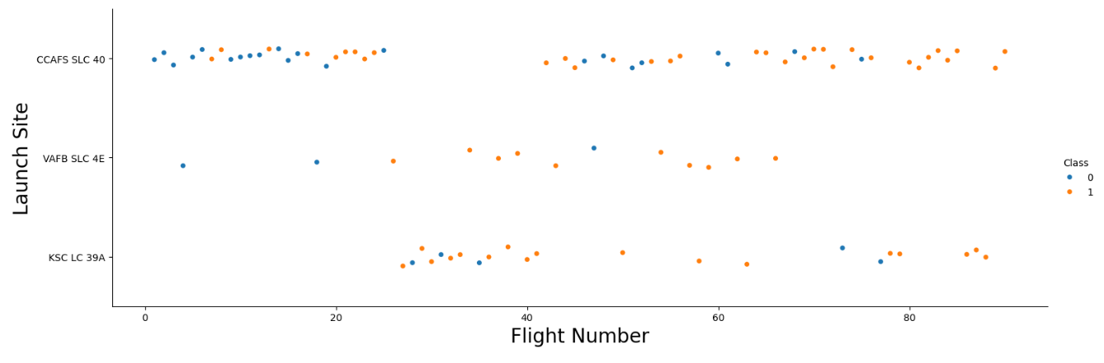
Flight Number vs. Launch Site
Different launch sites have different success rates. CCAFS LC-40, has a success rate of 60 %, while KSC LC-39A and VAFB SLC 4E has a success rate of 77%.

Slide 19
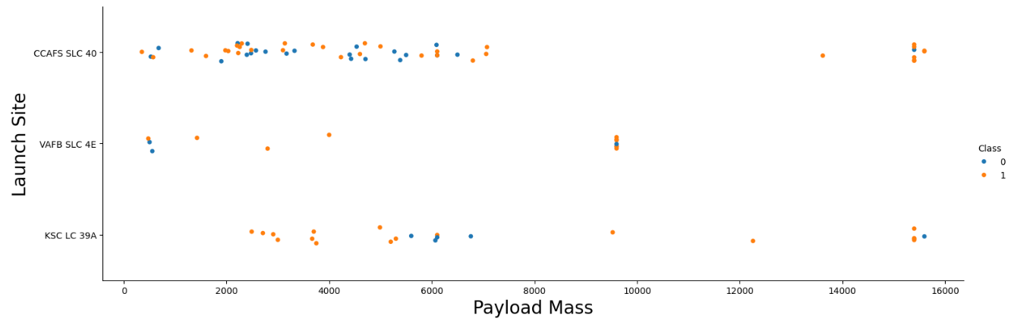
Payload vs. Launch Site
The more massive the payload, the less likely the first stage will return. For the VAFB-SLC launchsite there are no rockets launched for payload mass greater than 10000.

Slide 20
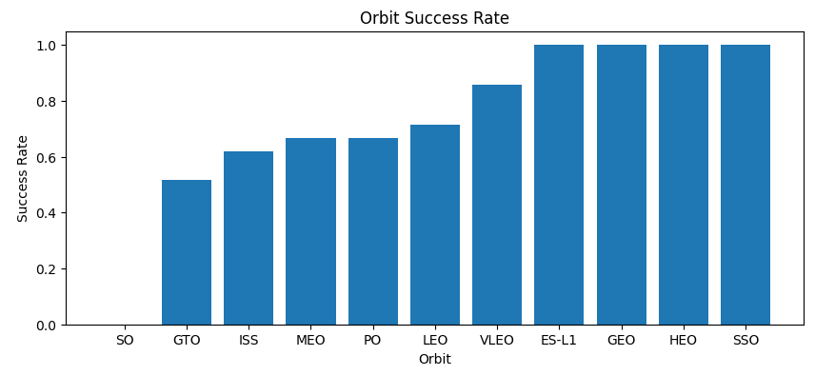
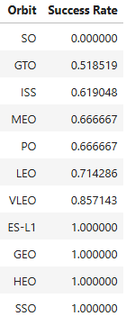
Success Rate vs. Orbit Type
The orbits ES-L1, GEO, HEO, and SSO has the highest success rate.

Slide 21
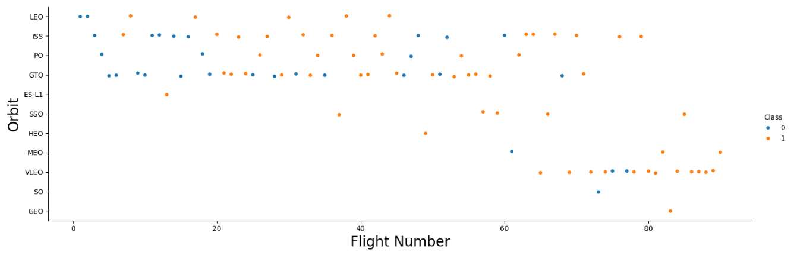
Flight Number vs. Orbit Type
The LEO orbit the Success appears related to the number of flights. There seems to be no relationship between flight number when in GTO orbit.

Slide 22
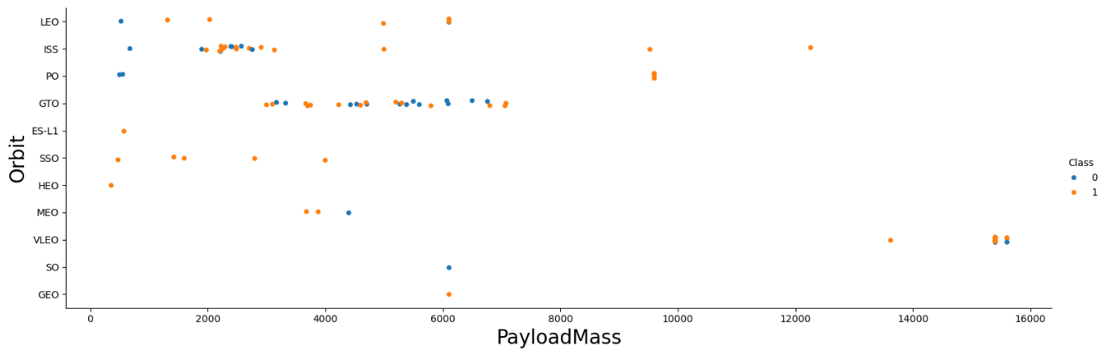
Payload vs. Orbit Type
With heavy payloads the successful landing or positive landing rate are more for Polar, LEO and ISS.

Slide 23
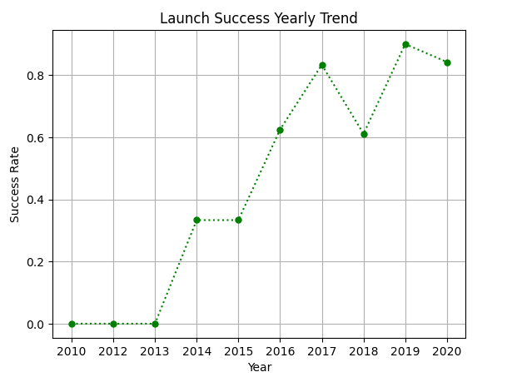
Launch Success Yearly Trend
The success rate since 2013 kept increasing till 2020.
The largest increase in trend was the four years between 2013 and 2017.

Slide 24
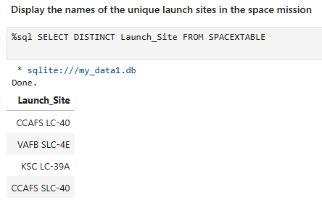
All Launch Site Names
SpaceX launch facilities:
Cape Canaveral Space Launch Complex 40 (CCAFS SLC-40, CCAFS LC-40)
Vandenberg Space Force Base Space Launch Complex 4E (VAFB SLC-4E)
Kennedy Space Center Launch Complex 39A (KSC LC-39A)

Slide 25
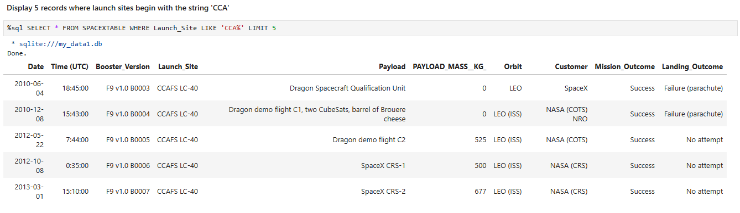
Launch Site Names Begin with 'CCA'
Find 5 records where launch sites begin with `CCA`

Slide 26
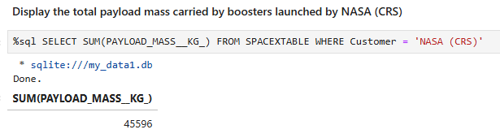
Total Payload Mass
Calculate the total payload carried by boosters from NASA.

Slide 27
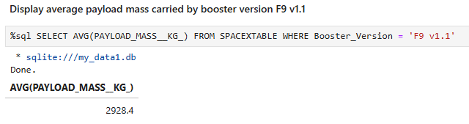
Average Payload Mass by F9 v1.1
Calculate the average payload mass carried by booster version F9 v1.1.

Slide 28
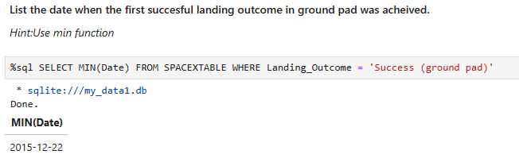
First Successful Ground Landing Date
Find the dates of the first successful landing outcome on ground pad.

Slide 29
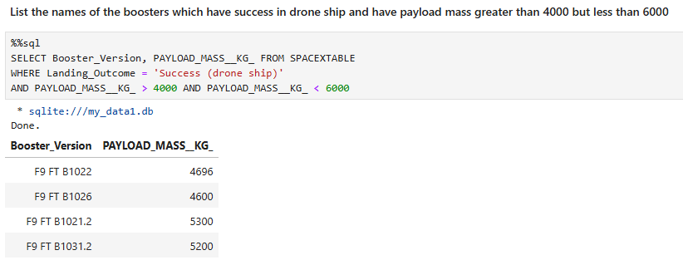
Successful Drone Ship Landing with Payload between 4000 and 6000
List the names of boosters which have successfully landed on drone ship and had payload mass greater than 4000 but less than 6000.

Slide 30
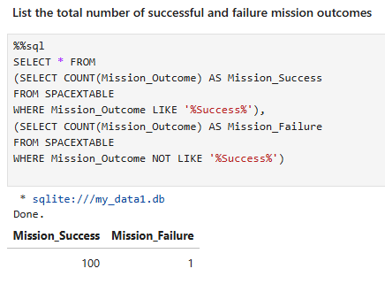
Total Number of Successful and Failure Mission Outcomes
Calculate the total number of successful and failure mission outcomes.

Slide 31
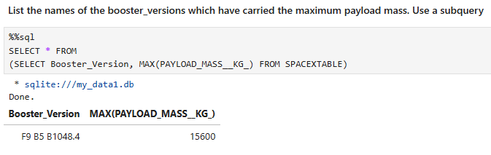
Boosters Carried Maximum Payload
List the names of the booster which have carried the maximum payload mass.

Slide 32
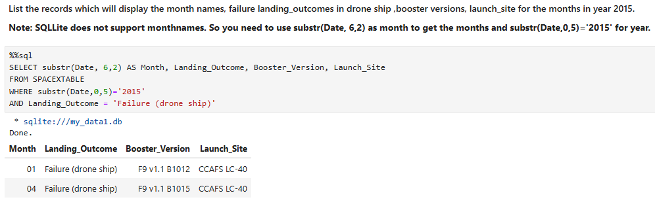
2015 Launch Records
List the failed landing_outcomes in drone ship, their booster versions, and launch site names for in year 2015.

Slide 33
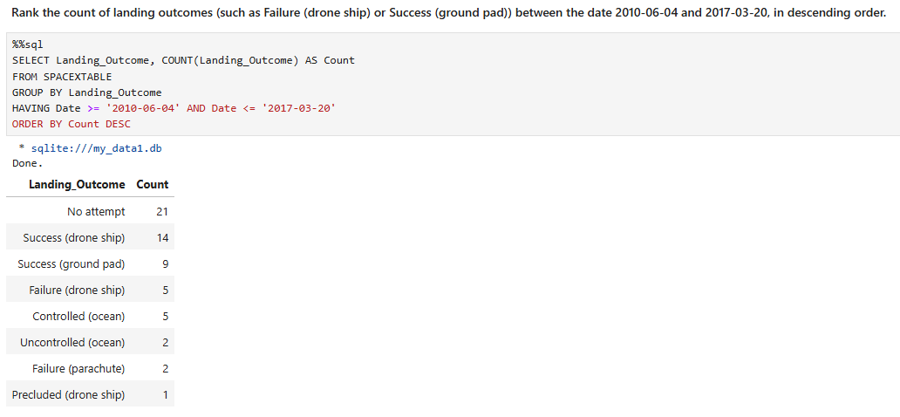
Rank Landing Outcomes Between 2010-06-04 and 2017-03-20
Rank the count of landing outcomes (such as Failure (drone ship) or Success (ground pad)) between the date 2010-06-04 and 2017-03-20, in descending order.

Slide 34

Section 3

Slide 35
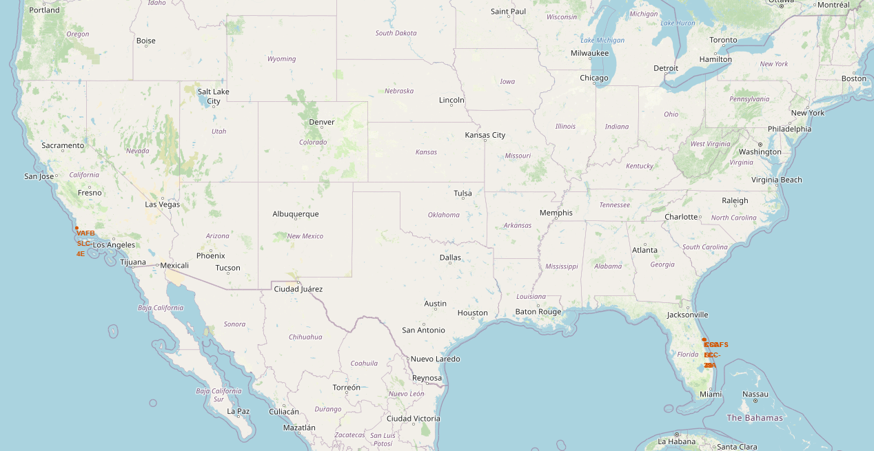
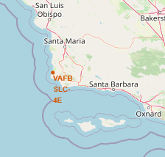
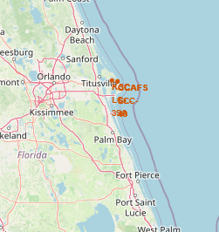
SpaceX Launch Sites
SpaceX launch sites are located on the East and West coasts in the southern United States, Florida and California (nearer to the equator).

Slide 36
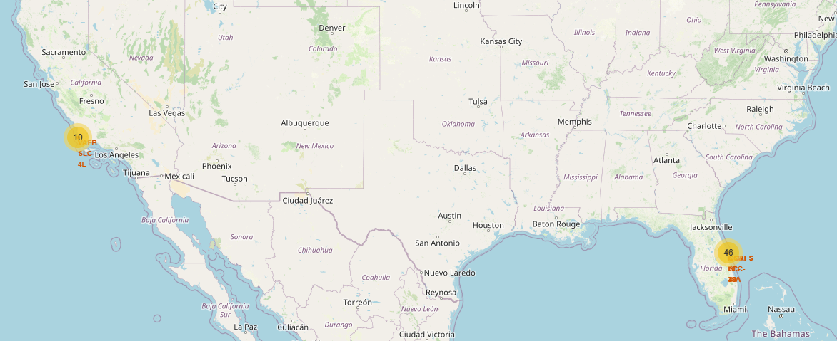
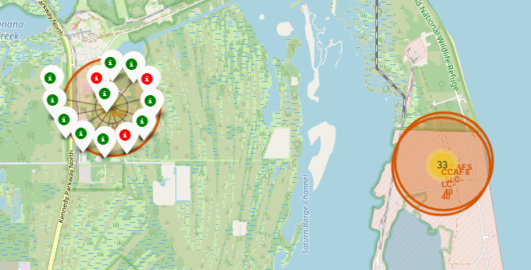
Launch Outcomes at Launch Sites
Launch outcome markers at launch sites (green=success, red=failure).

Slide 37
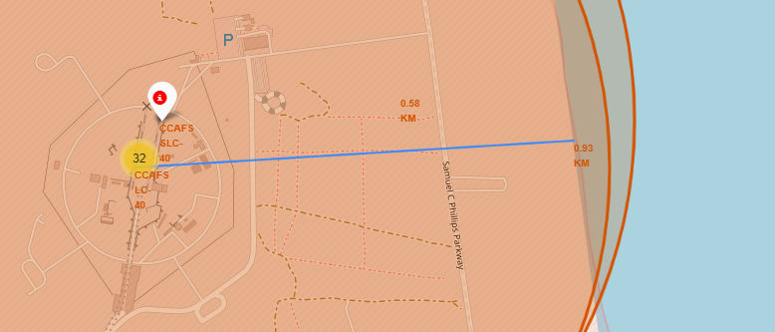
Launch Site Proximities
Exploring the generated map shows the CCAFS LC 40 launch site is almost one kilometer (about a half mile) from the Atlantic coast.

Slide 38

Section 4

Slide 39
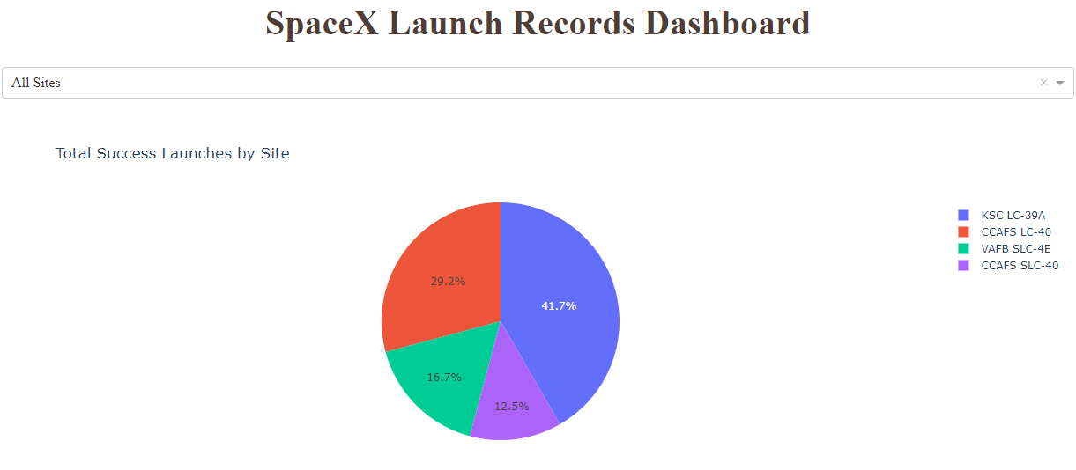
Total Success Launches for All Sites
KSC LC-39A has the highest success rate and CCAFS SLC-40 the lowest.

Slide 40
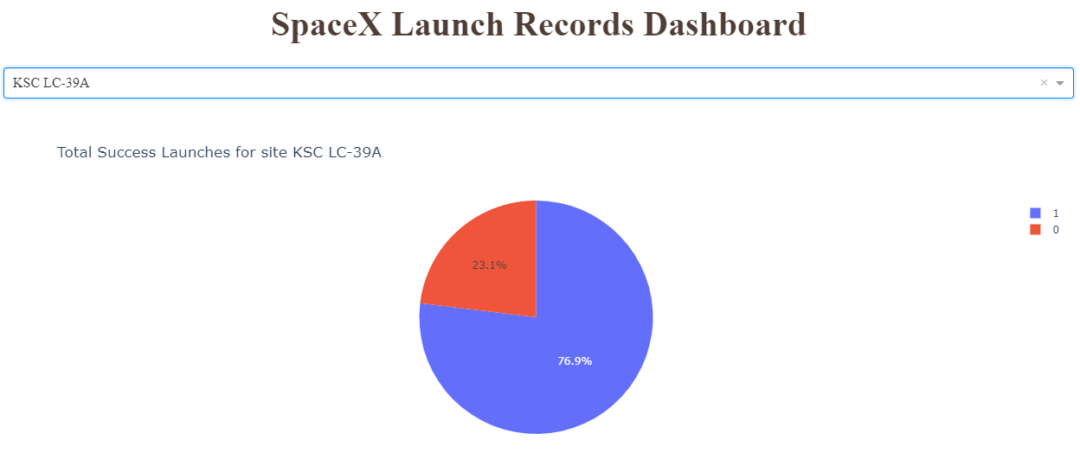
Launch Site KSC LC-39A
Site KSC LC-39A has the highest success rate of 76.9%.

Slide 41
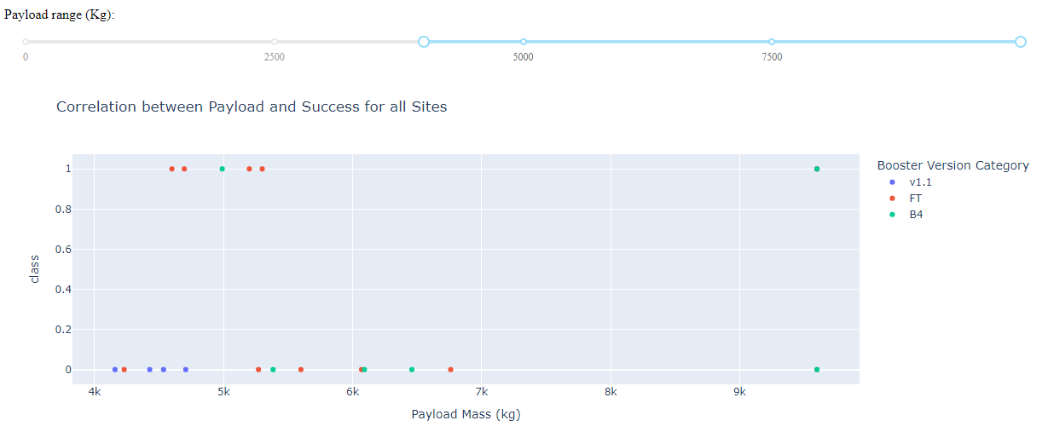
Payload vs. Launch Outcome for All Sites
Payload vs. Launch Outcome scatter plot for all sites, with payload selected for 4000 and higher.

Slide 42

Section 5

Slide 43
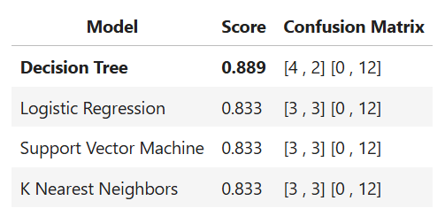
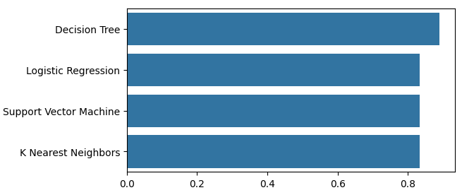
Classification Accuracy
Overall the models had nearly the same accuracy, with the Decision Tree model performing slightly better.

Slide 44
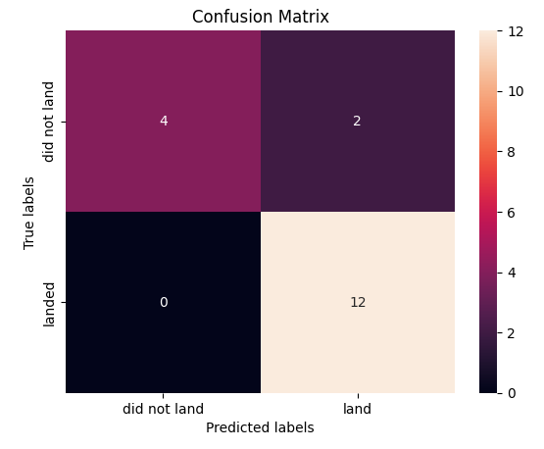
Confusion Matrix for Decision Tree
Overall the models had nearly the same accuracy, with the Decision Tree model performing slightly better.
The Decision Tree models benefits from being highly interpretable and its features easy to understand by decision makers.

Slide 45
Conclusions
SpaceX has gained worldwide attention for a series of historic milestones. It is the only private company ever to return a spacecraft from low-earth orbit.
SpaceX advertises Falcon 9 rocket launches on its website with a cost of 62 million dollars wheras other providers cost upward of 165 million dollars each, much of the savings is because Space X can reuse the first stage.
If it can be determine if the first stage will land successfully, we can determine the cost of a launch.
The dataset includes a record for each payload carried during a SpaceX mission into outer space. This information can be used if an alternate company wants to bid against SpaceX for a rocket launch.

Slide 46
Appendix
Github project repository: https://github.com/davidnicewonder/IBM-Applied-Data-Science-Capstone

Slide 47


